Slide 1


DRAFT v1
SkyNet
Roadmap 2020
08 – Dec 2016

Slide 2
Agenda
DRAFT v1
SkyNet’s Business
Use Cases & Recommendations
Implementation Estimates

Slide 3
Understanding SkyNet’s Business
DRAFT v1
Existing:
Produces radio transceiver for field based operators (FBO)
Potential:
- Airline transponders
- Monetization of transponder data
- Create additional services for FBOs

Slide 4
Agenda
DRAFT v1
SkyNet’s Business
Use Cases & Recommendations
Implementation Estimates

Slide 5
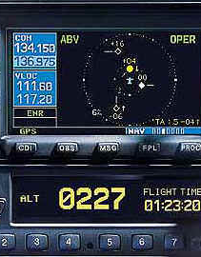
Use Case 1: Identify most common aircraft types for ADS-B transponder installation
DRAFT v1
Combine the FAA and SkyNet’s transponder data to identify all commercial aircraft not fitted with ADS-B device
Summarize data by aircraft type and airline

Slide 6
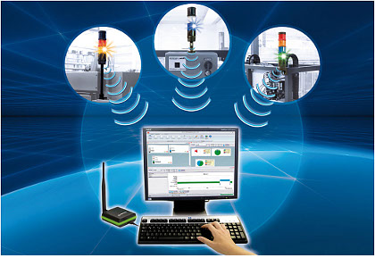
Use Case 2: Leverage real-time streaming of ADS-B data to provide value-added intel for new and existing FBOs
DRAFT v1
Minimize Target Start-up Approval Time (TSAT)
Enable FBO staff to realize greater flexibility when reacting to various operational events
Provide the airlines with better customer service in the event of flight delays

Slide 7

Use Case 3: Can the data extrapolated in Use Case 2 be further utilized in new products?
DRAFT v1
Embedded light-weight appliances to overcome deficiency of radio by supplying both visual data and audio communication
Added advantage in that FAA certification is not required

Slide 8
Agenda
DRAFT v1
SkyNet’s Business
Use Cases & Recommendations
Implementation Estimates

Slide 9
Roadmap 2020
DRAFT v1
UC1: Aircraft Identification
UC3: Additional Opportunity
UC2: Data Monetization
Business functionalities
Analytical Modelling
Data Processing Platform
Data Generation
Process

Slide 10
Financial Summary
DRAFT v1
 | Use Case 1 | Use Case 2 | Use Case 3
Investments - Internal – Think Big Services | 2,000,000 90,000 | 100,000 900,000 | 20,000,000 450,000
Revenues
Transponder sale (90% GM) | 2,115,000 (47) |  | 45,000,000 (1000)
Portal subscription |  | 2,400,000 (200 x12)
Mobile App Sales |  | 5,000,000 (1M)
ROI | N/A | 740% | 220%
All figures are in USD.
The details behind the calculation shall be disclosed in our commercial proposal.
*DISCLAIMER*: Please note that the above financial projections do not include any internal and external operating expenditures

Slide 11

DRAFT v1
Thank you for your attention!
Any questions?
Blank Layout

